Slide 1
Intern Work Summary
Harman Ransi
8/16/23

Slide 2
Presentation Outline
Project Overview / Goal
Project Approaches
Project Deliverables

Slide 3
Project Overview / Goal

Slide 4


Project Overview / Goal
Food Testing Panels
- panels are ran to test new food products in development and gather data
- data needs to be analyzed correctly to make good business decisions
* analyze / visualize if two products in a panel are equivalent or not
Control Product Old
Test Product(s)
New
Test products are evaluated by being compared to the control product

Slide 5
Project Approaches
Old vs New Approach

Slide 6
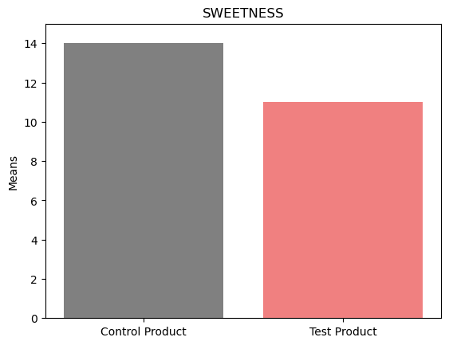
Project Approaches
Previous Analytics Team
- plotted averages of panel responses to determine
product equivalence
- problematic… variation in data not considered
1st : other variables in the dataset
• panelist, age of product, time of testing
2nd : panelist responses variation
• factors such as diet, race, age, etc.
• may be small variation in responses
(adds up quick w/ more panelists)
^ critical to consider these factors
Representative Plot
(Scale of 0 to 15)

Slide 7
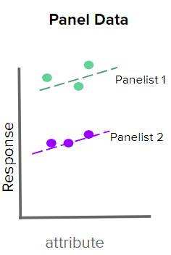
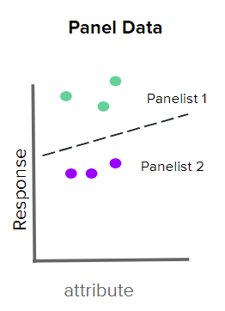
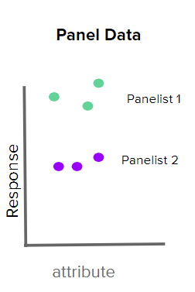

Project Approaches
New Approach
- Linear Mixed Effects Model (LMER) --> built using statsmodels in Python
Benefit: capture variation in data!
• all variables in the dataset
• panelist variation
- Formula
Response = attribute + product + product_age + [interactions] (grouped by panelists)
Accuracy -> R² is greater than 0.9 for each panel
^ 90%+ accurate on tested data!
Makes a line of best fit for EACH panelist to account for variation!

Slide 8
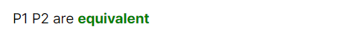
Project Approaches
Determining Product Equivalent w/ Model
- Confidence Intervals
• predicted avg. response from the model
i.e. Control Product’s Sweetness (11.48 to 11.51)
Test Product’s Sweetness (11.37 to 11.45)
^ avg. shown as range to account for data variance!
Equivalence Analysis
• Comparing Avg. Responses
less than 0.5 apart -> products are equivalent
greater than 0.5 apart -> products aren’t equivalent
0.5 -> business proposed metric
(11.48 – 11.45 = 0.03 apart… equivalent)
• analysis displayed in the front-end

Slide 9
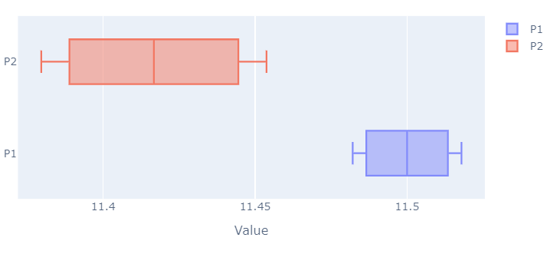
Project Approaches
Visualizing Predicted Averages
- Additional Visualization
• confidence interval plot
• visualizes range of each product’s predicted response
Boxplot Visualization

Slide 10
Project Deliverables
Front-End using Next.js

Slide 11
Project Deliverables
Demo
- Reference
• Link

Slide 12
Project Deliverables
Business Benefits
- Original Goal Achieved -> analyze / visualize if two products in a panel are equivalent
- Potential to Reduce Panel Cost
• Cut back on repeat panels
• New LMER model has higher data utilization
• $8.3 Million Figure = $2,500 / panel, 4 panels / week, 4 groups / panel, across 4 locations
^ 2 panels a week -> potential to save $4.1 Million!

Slide 13
Thank you for your attention during this presentation
Questions?

